Slide 1

UNIVERSITY INSTITUTE OF ENGINEERING
COMPUTER SCIENCE ENGINEERING
Bachelor of Engineering (Computer Science & Engineering)
Subject Name: Block chain Technology
Subject Code: 20_CST-412
Pseudo anonymity and anonymity
Mapped with CO4
Prepared By:
Er. Ankita Sharma
DISCOVER . LEARN . EMPOWER

Slide 2

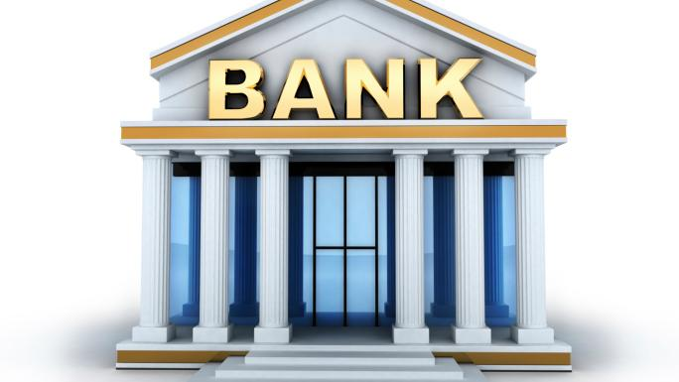





Bitcoin
Intent of Bitcoin: replacing banks!
Technical guarantees:
Distributed consensus
Pseudo-anonymous

Slide 3








How Does Bitcoin Work?
Miners
Proof of work
Alice → Bob
…
Ram → Hari
Transaction
Alice→ Bob
Transactions inside block
…
Transaction Confirmed
Alice→ Bob
Normally 6 blocks after transaction
Alice
Publicly available blockchain
Bob

Slide 4


Background and Related Work
Works on Anonymity concern:-
Anonymous
Not Anonymous
Mixers
E.g. Bitcoin Blender
Graph Analysis
Altcoins
E.g. DashCoin
Third Party Crawling
E.g. Bitcoin forums
Trustless Coinjoin
E.g. Coinshuffle
Interacting with merchants/users
References:
Tim Ruffing, et al. Coinshuffle: Practical decentralized coin mixing for bitcoin. In European Symposium on Research in Computer Security, pages 345–364. Springer, 2014.
Gregory Maxwell. Coinjoin: Bitcoin privacy for the real world,2013. Available at https://bitcointalk.org/?topic=279249.
DashCoin, Anonymous peer-to-peer Internet currency. Available at http://dashcoin.info/
References:
Malte Moser, et al. An inquiry into money laundering tools in the bitcoin ecosystem. In eCrime Researchers Summit (eCRS), 2013, pages 1–14. IEEE, 2013
Michael Fleder, et al. Bitcoin transaction graph analysis. arXiv reprint arXiv:1502.01657, 2015
Sarah Meiklejohn, et al. A fistful of bitcoins: characterizing payments among men with no names. In Proceedings of the 2013 conference on Internet measurement conference, pages 127–140. ACM, 2013
But, do users really care about anonymity? Or to what extent they care about it?

Slide 5
Contributions
Anonymity Metrics
Direct metric: hide their real-world identity?
Indirect metric: hide their intention?
Macro view analysis of anonymity concern of users
The collective anonymity concerns from all users
Micro view analysis of critical addresses
Addresses from big organizations: Hot and cold wallet addresses.
Bitcoin “believers”: Stock buyer addresses
Addresses from backbone participants: Miners addresses
BIGDATA: ~10 years of transaction data (~230 GB)!

Slide 6
Bitcoin Transaction Graph Looks Like
Transaction
Alice → Bob
Address
Transaction
M
Mining Transaction
M

Slide 7
Constructing Bitcoin Transaction Graph
Bitcoin Core
(v0.16.0)
Blockchain Raw Data
Rusty Block Parser
Bipartite Graph Generator
CSV Dumps
Anonymity concern insights!
Graph Analysis
Graph Project Start
Edge Lists(BTC, timestamps)
Graph in correct format
References:
Bitcoin Core Software. Available at https://bitcoin.org/en/bitcoin-core/
Rusty blockparser github repository. Available at https://github.com/gcarq/rusty-blockparser

Slide 8
Outline
Introduction and Background
Anonymity Metrics
Macro Analysis
Micro Analysis
Conclusions

Slide 9
Anonymity Metrics: How to Detect Anonymity Concern?
Metric 1 (Address Reusing Frequency). Reusing an address = low concern on anonymity.
AddressReuse. Available at https://en.bitcoin.it/wiki/Address reuse
Satoshi Nakamoto. Bitcoin: A peer-to-peer electronic cash system. 2008
Metric 2 (Zero Balance). Addresses turned into zero balance = concern about anonymity.
Metric 3 (Address Intention). Hiding intention = cares about anonymity.
Important because identifying the intentions of the addresses helps grouping them together into some category to speed up the deanonymization process

Slide 10
Outline
Introduction and Background
Anonymity Metrics
Macro Analysis
Micro Analysis
Conclusions

Slide 11
Causes of Diameter Dynamics
Unchanged
Unchanged
A1
A2
A3
A1
A2
A3
T1
T2
T1
T2
A4
T3
T3
Increased
Decreased
A1
A2
A3
A1
A2
A3
T1
T2
T1
T2
A4
T3
T3
New addresses: Diameter remains unchanged or increases
No new addresses: Diameter remains unchanged or decreases
Diameter: The maximum shortest path between any 2 vertices in graph.
7/27/2023

Slide 12
Macro View Analysis of Anonymity Concerns
Connected components remain separated
Majority: anonymity concern users
Majority: unconcerned users
Remain consistent
New address attaching on tail
Diameter : Main connected component with majority of vertices

Slide 13
New Address vs Old Address to Receive Bitcoin
On average, old addresses: 55.25% vs new addresses: 44.75% to receive Bitcoin
Exception: establishment of Bitcoin exchange centers + price hike probably caused
New users joining Bitcoin → the increase of new address usage.

Slide 14
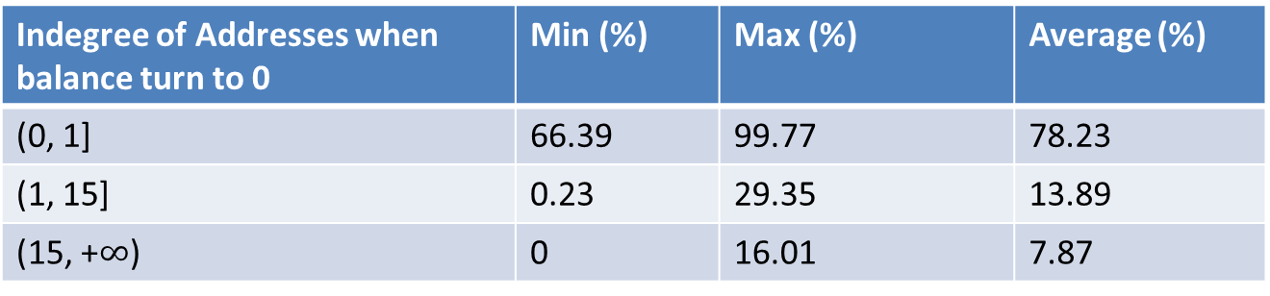
Changes Anonymity Concern
Addresses anonymity concerns at different indegrees’
Indegree of Addresses when balance turn to 0 | Min (%) | Max (%) | Average (%)
(0, 1] | 66.39 | 99.77 | 78.23
(1, 15] | 0.23 | 29.35 | 13.89
(15, +$∞$) | 0 | 16.01 | 7.87
Addresses are less likely to have a sudden change in anonymity concerns.

Slide 15
Rich Vs Poor Addresses
Events of hacking and stealing
Rich Addresses: Top 25% rich Bitcoin addresses.
Poor Addresses: Remaining non-zero Bitcoin addresses.
Rich addresses are more concerned about anonymity.
References:
Timithy B. Lee. A brief history of Bitcoin hacks and frauds. Available at https://arstechnica.com/tech-policy/2017/12/a-brief-history-of-bitcoin-hacks-and-frauds/

Slide 16
Outline
Introduction and Background
Anonymity Metrics
Macro Analysis
Micro Analysis
Conclusions

Slide 17
Stock Buyer Addresses
Bitcoin price (USD)
Stock buyer address features: only receive the Bitcoin but never spent
Out-degree = 0.
This is how we reveal their intentions.
More insights: stock addresses are immediately influenced by the exchange rate of Bitcoin.

Slide 18
Miners: Before and After Bitcoin Price Hike (2 real cases)
CASE I
Miner accumulates the mined Bitcoins
Low Anonymity concern
M1
1
4
5
Addresses
50 BTC
150 BTC
Address with BTC
M2
2
6
7
10
11
Transaction
50 BTC
2010-06-04 to 2010-06-15
M3
3
8
9
M
Mining Transaction
50 BTC
16.00036303 BTC
17.97607515 BTC
23
21
16.00036719 BTC
26
27
25
24
18
15
16
2018-01-05
22
20
19
17
14
8
50 BTC
M1
1
2
3
4
5
6
7
9
10
12
2010-02-21
2011-06-14
2017-11-19 →
11
13
CASE II
Miner splits the mined Bitcoins, when Bitcoin price rises.
Change in anonymity concern

Slide 19
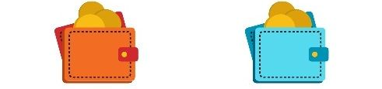
Hot and Cold Wallets of Big Organizations
Hot Wallet | Cold Wallet
Connected to the internet | Offline (hard disk or paper)
Convenient to use but vulnerable to hacking | More secured but not convenient to use

Slide 20
Hot Wallet Addresses of Big Organizations
Tag | Address ID | Total inflow from other addresses | Bitcoin balance | Degree
Deepbit | 1VayNert3x1KzbpzMGt2qdqrAThiRovi8 | 25467352.64 | 0.2 | 1565611
SatoshiDICE Hot Wallet | 18uvwkMJsg9cxFEd1QDFgQpoeXWmmSnqSs | 399678.8714 | 0.00053 | 414842
SatoshiDICE Hot Wallet | 1MSzmVTBaaSpKDARK3VGvP8v7aCtwZ9zbw | 386456.4036 | 0.00033 | 414270
SatoshiDICE Hot Wallet | 1PeohaRGaTF8cSzDqP1yYfzDah66xiriEQ | 384443.0361 | 0.00079806 | 413407
SatoshiDICE Hot Wallet | 1Bd5wrFxHYRkk4UCFttcPNMYzqJnQKfXUE | 383879.8434 | 0.05339999 | 415362
SatoshiDICE Hot Wallet | 15fXdTyFL1p53qQ8NkrjBqPUbPWvWmZ3G9 | 383444.5918 | 0.00028 | 415042
FoxBit Hot Wallet | 1FoxBitjXcBeZUS4eDzPZ7b124q3N7QJK7 | 156329.1069 | 0.04314468 | 560202
Unknown | 13vHWR3iLsHeYwT42RnuKYNBoVPrKKZgRv | 17600542.04 | 0.00306531 | 1011905
Unknown | 19iVyH1qUxgywY8LJSbpV4VavjZmyuEyxV | 9326468.877 | 0.00000651 | 430643
Hot wallet addresses of big organizations:
Private key is online for convenience
Has relatively high degree, with low accumulations of Bitcoin but higher flow through them.
Feature: Degree >= 50,000, flow >= 150,000 BTC , Accumulated BTC <=10 BTC
We can help uncover hidden (similar) hot wallets!
Notes:
https://www.blockchain.com/
https://bitinfocharts.com/top-100-richest-bitcoin-addresses.html

Slide 21
Outline
Introduction and Background
Anonymity Metrics
Macro Analysis
Micro Analysis
Conclusions

Slide 22
Conclusions
Majority of the users don't care about the anonymity
Most of the addresses that are concerned about anonymity are rich addresses
Users start concerning about anonymity when the price of Bitcoin goes high
Seen with a real examples of miners
Rich addresses concerning more when price hiked, and hacking events started
Stock addresses don’t hide their intent of making profits on Bitcoin price hike.
With design of some filters, one can find the hot wallet addresses and cold wallet addresses of big organizations (like exchange centers, gambling sites, miners etc.)

Slide 23


Thank You & Questions? Opensource at: https://github.com/Anil-Gaihre/Bitcoin_AnonymityConcern Contacts: Anil_Gaihre@student.uml.edu

Slide 24
Back Up Slides

Slide 25
Miners Addresses
Exchange centers established.
Method of anonymity analysis: Claim 3 (Intention)
The mining addresses along with their transactions remain as separate connected component if none of them transact with main connected component.
Detected intentions of saving Bitcoin!
At the date of download, some of the small connected components were detected from around 2010

Slide 26
Construction of Bitcoin transaction graph
Raw Data Download (January 3, 2009 to June 7, 2018)
Bitcoin Core v0.16.0
Raw data size of approximately 230 GB
Parsing:
Rusty Block parser (https://github.com/gcarq/rusty-blockparser)
Output: csv dump
Transaction-address bipartite graph
Developed tool to process the csv dumps from the Rusty Block Parser
Output: Edge lists with Bitcoin as weights, Addresses/Transactions Maps, Transactions Timestamps
Compressed Sparse Row (CSR construction)
Graph project start (https://github.com/asherliu/graph_project_start)
Output: csr edge lists

Slide 27
What is Blockchain and Bitcoin?
Blockchain : A distributed ledger of transaction
Append only distributed ledger
Decentralized consensus used for validation
Collects the transactions in blocks and attach the blocks to maintain a linked list.
Miners to validate the transactions
Check for double spend
Bitcoin :
A blockchain based cryptocurrency
Most popular and widely used cryptocurrency
Users references to UTXO (Unspent Transaction Output), of a transaction in the blockchain.
Pseudo anonymous in nature

Slide 28
Appendices
Miners Real world examples
Case I Mining Transactions:
fa796ffd60affebb030d7ff8e81474ceb7e3fba91e92235f809469e434025f1b
e9e2747a9a10db68912d3215a4fda1a5ff0d4c018928851ac5f8e0e80d0c091c
c43ed2ff2dbc51f7c677ce88c416050e13e892707bd12738a1f68bdd81226c3e
Case II Mining Transactions
089bf008a36a182f816498f3f15aa56885dda745b678d8f9fd7f51b05aab502f

Slide 29
Result Validation
https://www.blockchain.com/
https://bitinfocharts.com/top-100-richest-bitcoin-addresses.html
Signed by Alice
Pay to Pkbob: H()

Slide 30
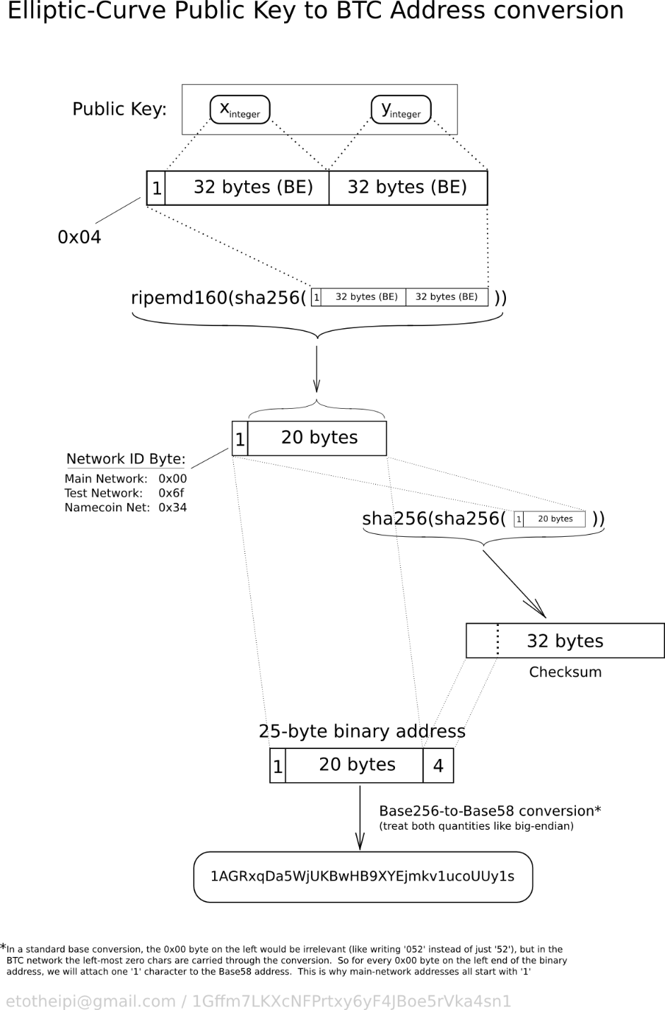
Bitcoin Address
A Bitcoin address is a 160-bit hash of the public portion of a public/private ECDSA keypair. Using public-key cryptography, you can "sign" data with your private key and anyone who knows your public key can verify that the signature is valid.
Notes:
https://en.bitcoin.it/wiki/Technical_background_of_version_1_Bitcoin_addresses

Slide 31
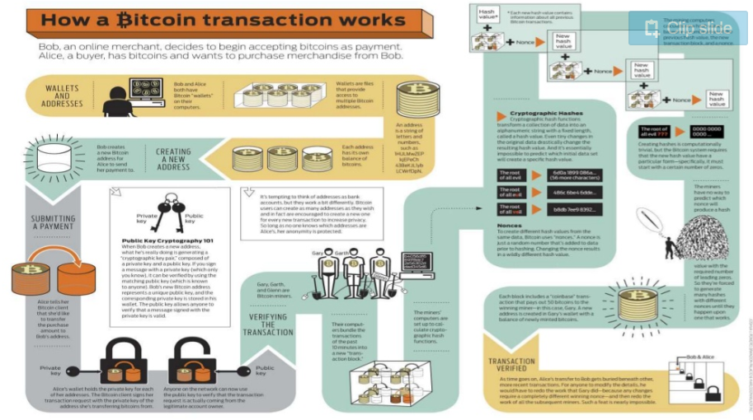
How addresses are created?
Notes:
https://www.slideshare.net/UtkarshGupta77/introduction-to-bitcoins-and-cryptocurrency

Slide 32
How a transaction is verified cryptographically?
Suppose Alice receives m, digital signature { m, sig=sign(m,K_{R}) }
Alice verifies m signed by Bob by applying Bob’s public key K_{u} to sig then checks verify(m, sig, K_{u}) = true or false?
If true, whoever signed m must have used Bob’s private key.
Alice thus verifies that:
Bob signed m.
No one else signed m.
Bob signed m and not m’.
Non-repudiation:
Alice can take (m, sig) to court and prove that Bob signed m.

Slide 33
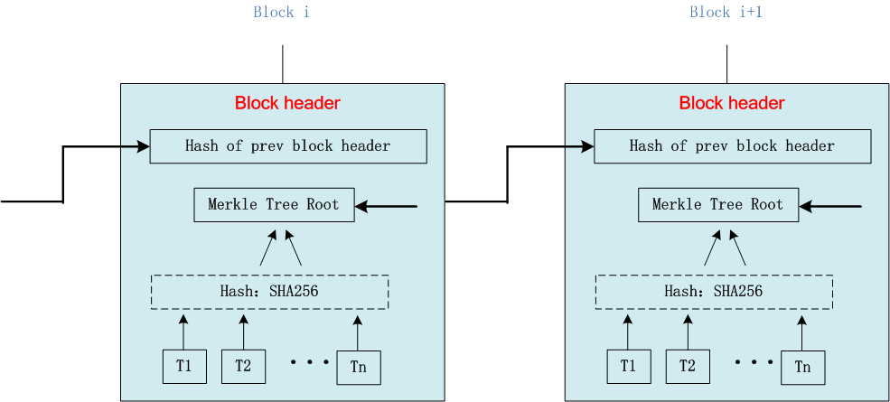
2.2 Block format in Bitcoin
Chain all blocks together
Guarantee the integrity of transactions in a block
A block contains “block head” and “block body”,
“block head” stores the previous hash of the last block header.

Slide 34
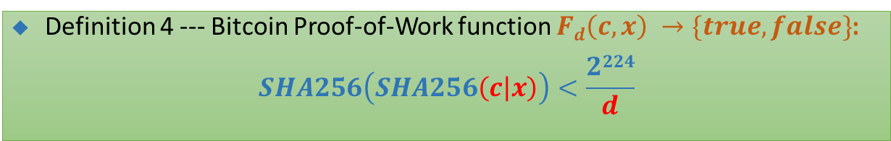
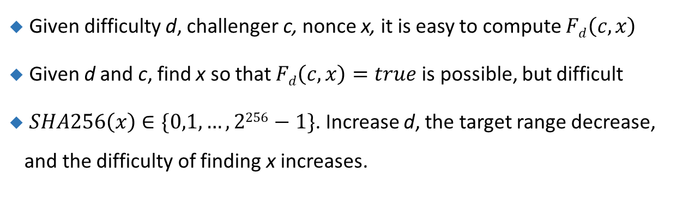
Core：Proof of Work --- solving a puzzle
Definition 4 --- Bitcoin Proof-of-Work function $Fd\left(c,x\right) →\{true, false\}$:
$$SHA256\left(SHA256\left(c | x\right)\right)<\frac{2224}{d}$$
Given difficulty d, challenger c, nonce x, it is easy to compute $Fd\left(c,x\right)$
Given d and c, find x so that $Fd\left(c,x\right)=true$ is possible, but difficult
$SHA256\left(x\right)∈\{0,1,…,2256−1\}$. Increase d, the target range decrease, and the difficulty of finding x increases.

Slide 35
Digital signature = signed message digest
Bob sends digitally signed message:
Alice verifies signature and integrity of digitally signed message:
large
message
m
H: Hash
function
H(m)
signed msg digest
Bob’s
private
key
digital
signature
(encrypt)
Sign(H(m), K_{R})
large
message
m
K_{R}
Bob’s
public
key
digital
signature
(decrypt)
Signed msg digest
H: Hash
function
K_{U}
+
Sign(H(m), K_{R})
H(m)
H(m)
equal
?

